Slide 1
Parallel Imaging Reconstruction Using Automatic Regularization
Jaeeun Lee
2018/08/07

Slide 2
Contents
Generalized pMRI
Index problem
Comparison between line by line and pixelwise encoding function inversion
Hybrid implementation
Coil sensitivity calibration
Tikhonov paper
Intro
Weighted least squares problem & inter-channel noise whitening
g-factor

Slide 3
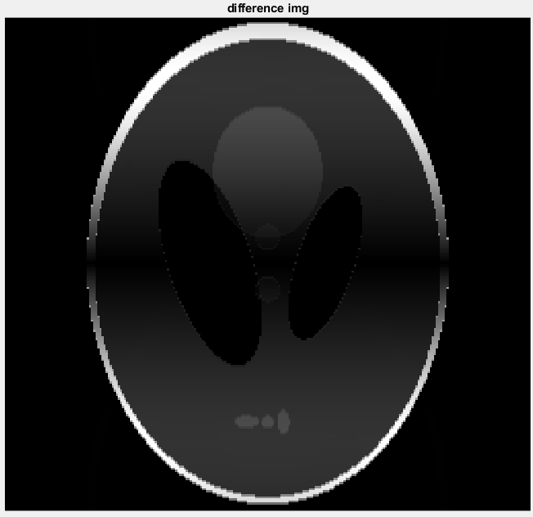
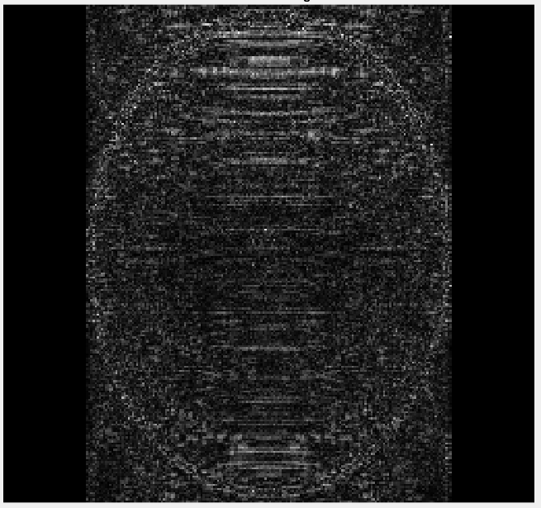
Generalized pMRI_1) index problem
Difference img (r_factor = 2)
Key : D.C
- we should find the d.c first in the full-sampled k-space data
Idx = 119 ~ -120
Idx = 120 ~ -119

Slide 4
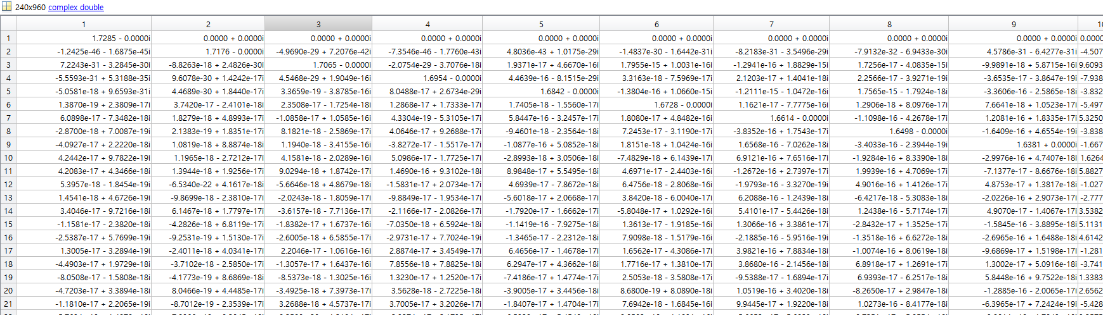
Generalized pMRI_2) Comparison between line by line and pixelwise encoding function inversion

Slide 5
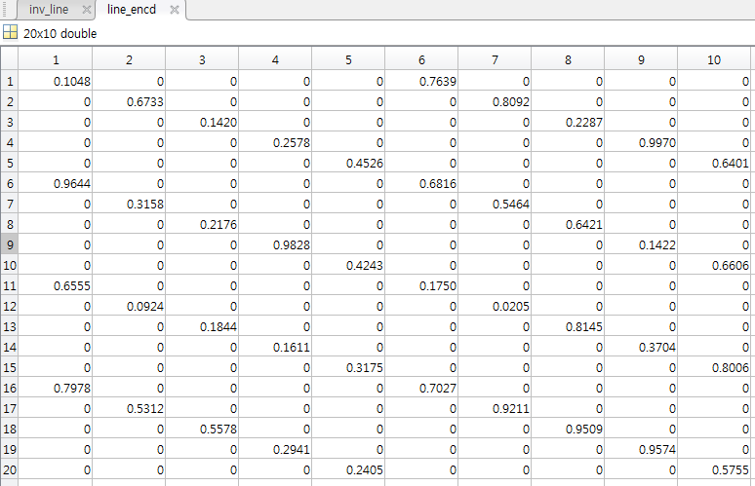
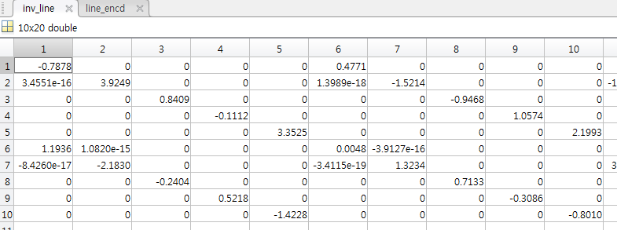
Generalized pMRI_2) Comparison between line by line and pixelwise encoding function inversion

Slide 6
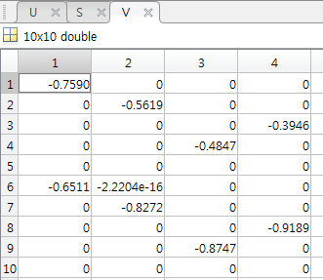
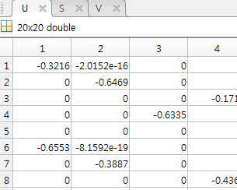
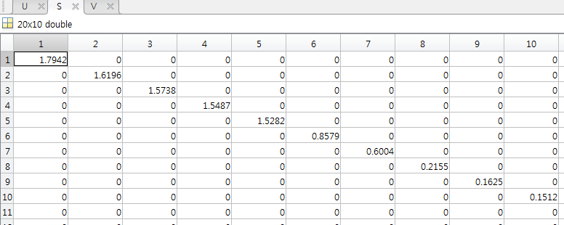
Generalized pMRI_2) Comparison between line by line and pixelwise encoding function inversion

Slide 7
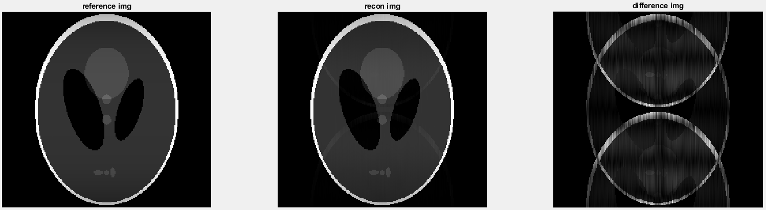
Generalized pMRI_3) Hybrid implementation
R = 2
Subblock = 1 (SMASH)
Noise st = 1e-5

Slide 8
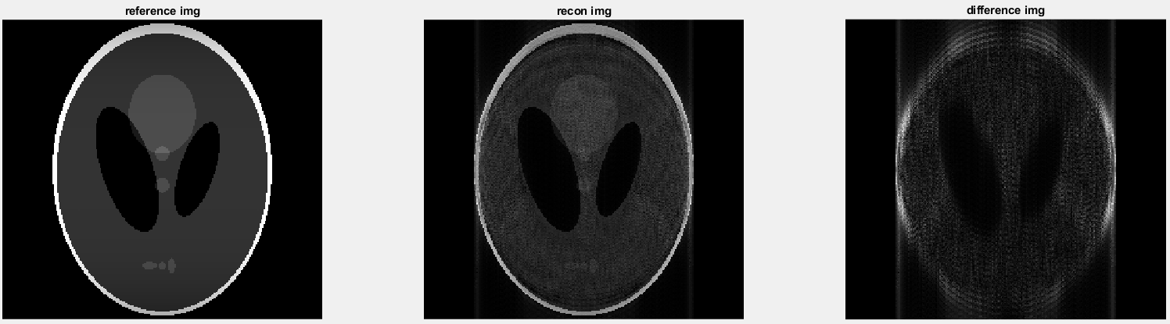
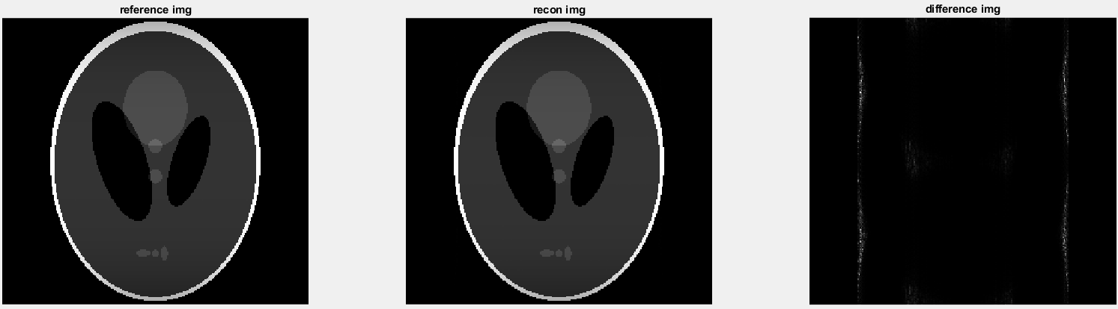
Generalized pMRI_3) Hybrid implementation
R = 2
Subblock = 24
Noise st = 1e-5
M = -22~25
M = 0~47

Slide 9
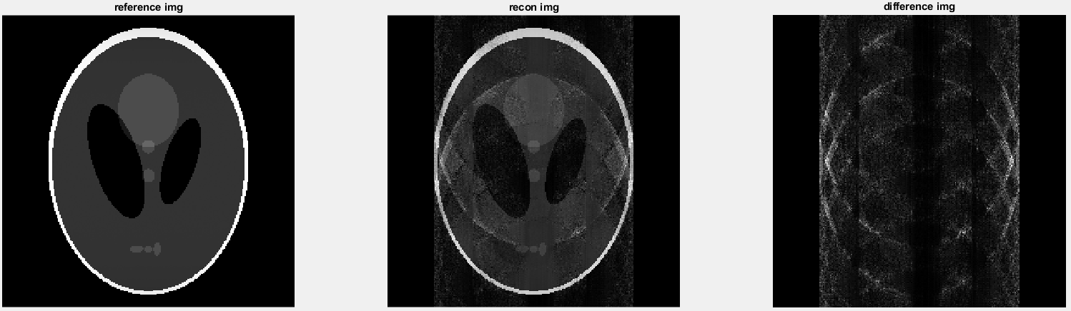
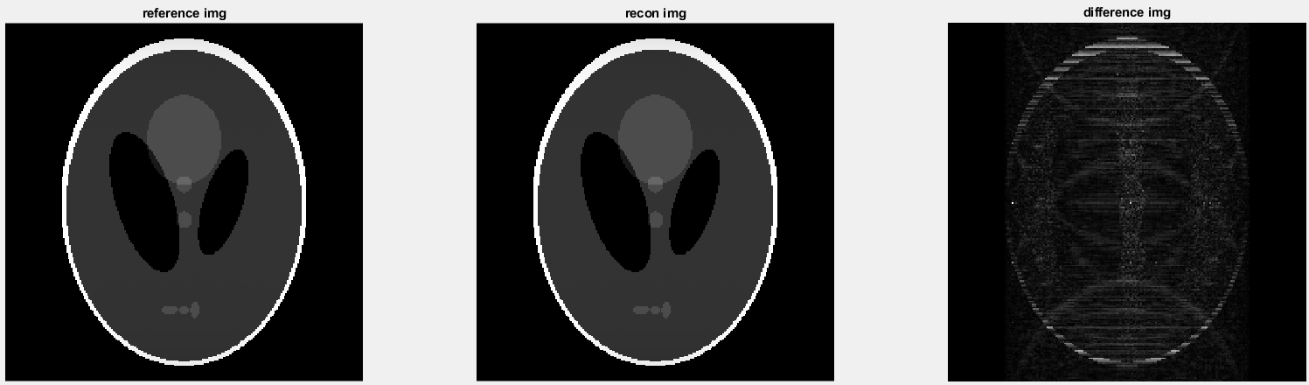
Generalized pMRI_3) Hybrid implementation
R = 6
Subblock = 20
Noise st = 0.1
R = 6
Subblock = 40
Noise st = 0.1

Slide 10



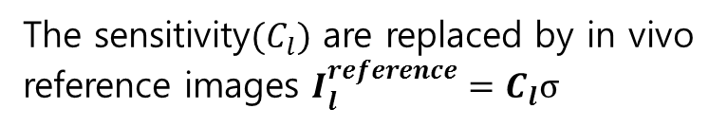

Generalized pMRI_4) Coil sensitivity calibration
Typically, rapidly-acquired low-resolution images are used as sensitivity references.
Reference img obtained with any component coil $l$
Differ from target spin density $ρ$
The sensitivity$(C_{l})$ are replaced by in vivo
reference images $I_{l}^{reference}=C_{l}σ$
$$\frac{I_{l}^{reference}}{σ} → filtering, smoothing →C_{l}$$
Special care must also be taken to avoid calibration errors, since the quotient image may be poorly behaved esp. in regions of low SNR

Slide 11

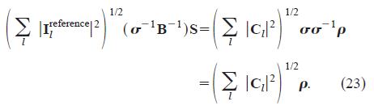
Generalized pMRI_4) Coil sensitivity calibration

Slide 12
Tikhonov paper_1) Intro
SNR is reduced due to
1. the reduced number of data samples ; inevitable
2. correlation in the spatial info(geometrical arrangement of the array coil) ; optimizing coil geometry
We can mitigate the noise amplification in SENSE reconstruction by utilizing Tikhonov regularization.
The advantages of regularized parallel MRI reconstructions was reported in various studies.
- regularization can potentially be used to unfold aliased images from an underdetermined system
A Full-FOV reference scan and the L-curve algorithm was employed to determine the optimum regularization parameter in this study.
g-factor maps are also used to demonstrate the effect of regularization on the noise of the unfolded images.

Slide 13

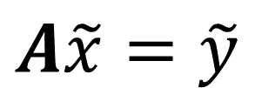
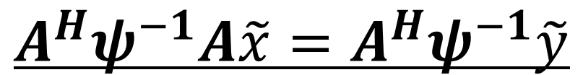

Tikhonov paper_2) Weighted least squares problem & inter-channel noise whitening
$$A\tilde{x}=\tilde{y}$$
In general, A is an overdetermined linear system
[Nc x m]
$$\tilde{x} :Full−FOV img$$
$$\tilde{y} :Folded img of each receiver coil$$
Weighted least squares problem
Col. Pic, row.pic
$$A^{H}ψ^{−1}A\tilde{x}=A^{H}ψ^{−1}\tilde{y}$$
$$ψ :the receiver noise covariance, [Nc x Nc]$$

Slide 14
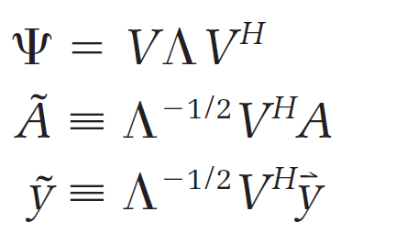
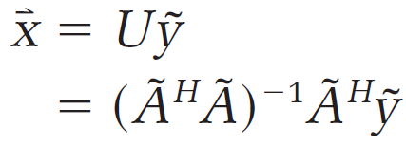
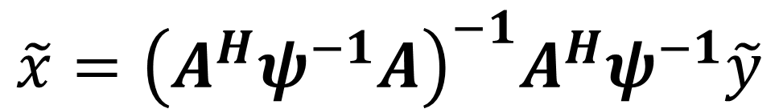
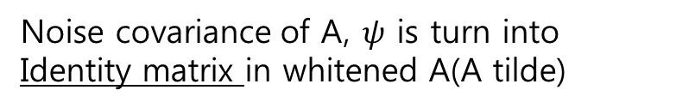
Tikhonov paper_2) Weighted least squares problem & inter-channel noise whitening
$$\tilde{x}={\left(A^{H}ψ^{−1}A\right)}^{−1}A^{H}ψ^{−1}\tilde{y}$$
$$ψ :the receiver noise covariance, [Nc x Nc]$$
Whitening transformation
Noise covariance of A, $ψ$ is turn into
Identity matrix in whitened A(A tilde)

Slide 15
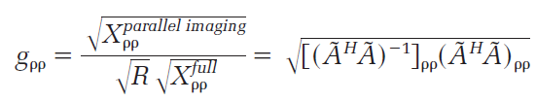
Tikhonov paper_3) g-factor
G-factor : quantified noise sensitivity
$$X :covariance of the reconstruction image vector x$$

